Slide 1
Don’t Reinvent the Wheel
3/4/16
“An expert is a man who has made all of the mistakes which can be made in a very narrow field.”
- Niels Bohr

Slide 2
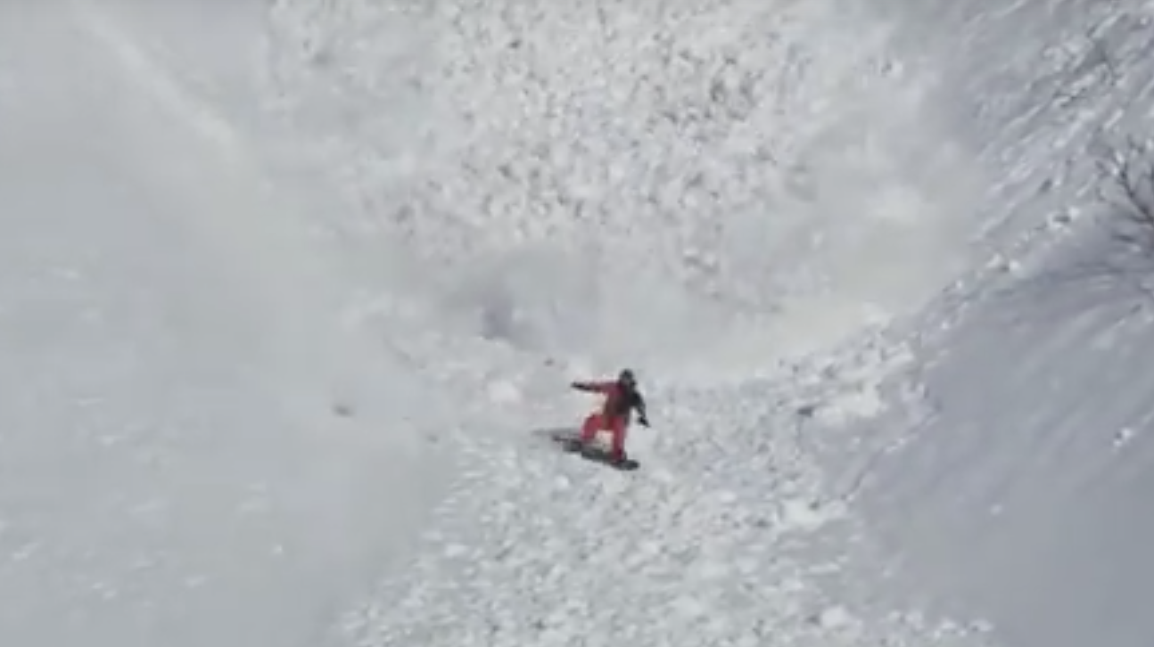
How many of you feel like this?
Notes:
https://www.youtube.com/watch?v=qvb2HyM5Hoo

Slide 3

What this is not
Not more work from someone who only thinks about science

Slide 4

Today
Design
Re-design
Discrepant events and questioning

Slide 5

Questions
“To question means to lay open, to place in the open. Only a person who has questions can have real understanding.” – Hans Georg Gadamer
Notes:
God – a – mare

Slide 6
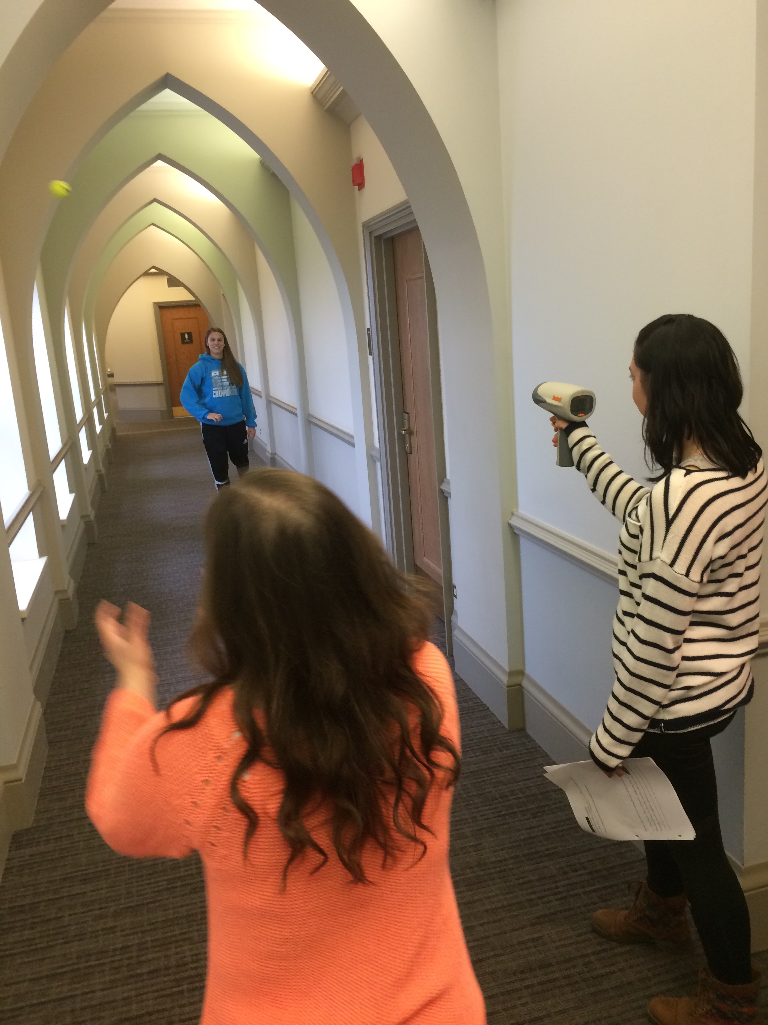
How do we start to think about science as inquiry? How do we encourage divergent thinking?
Predict
Explain
Observe
Explain

Slide 7


Water Labs and Prototypes
Introduce concepts and specialized vocabulary after children have gained firsthand experiences with the object or concept
Interact with students, have them interact with each other
Focus learning for discovery and concept construction

Slide 8

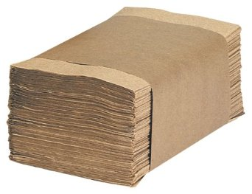
Aluminum Boats
Avoid brown, water re-distribution paper towels

Slide 9
Aluminum Boats
Will an aluminum foil boat float?
Make a model: Design a boat from a 20cm² piece of aluminum foil to hold as many washers as possible
Predict: How many washers will your boat hold?
Experiment: Draw a top and side view of your boat. Use a circle to represent where you will place washers

Slide 10
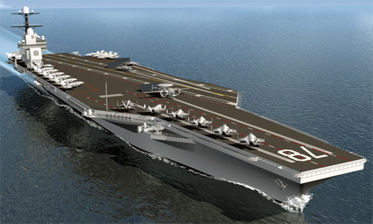
Why does this float when a rock will sink?

Slide 11
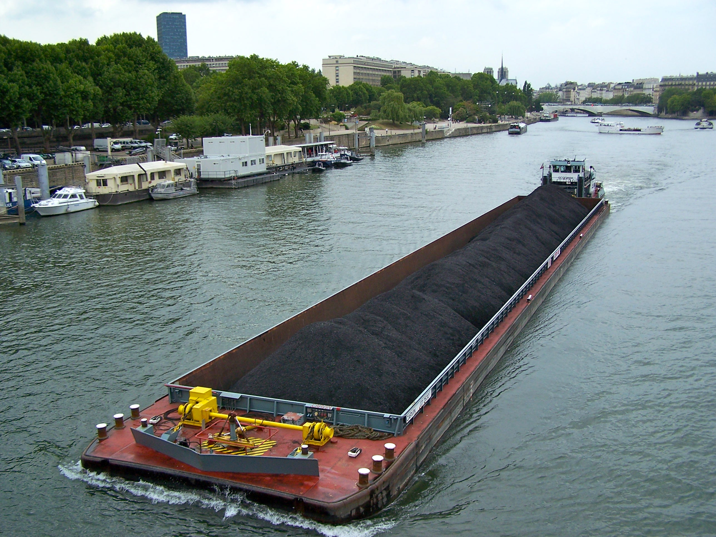
Design hint . . .

Slide 12

NSTA Recommendations
Elementary – minimum of 80% of instructional time for lab or field activities
Middle – 60%
High – 40%

Slide 13

Discrepant Events
Will it float?
Hydrophilic Crystals
Hydrophobic Sand
Colliding Steel Spheres
Bernoulli’s Bag
Cognitive Dissonance – the inconsistency between what one observes and what one believes
Notes:
9:30

Slide 14



Sink or float?
Last group came up with 12 hypotheses …
Notes:
DONE BY 11:50

Slide 15
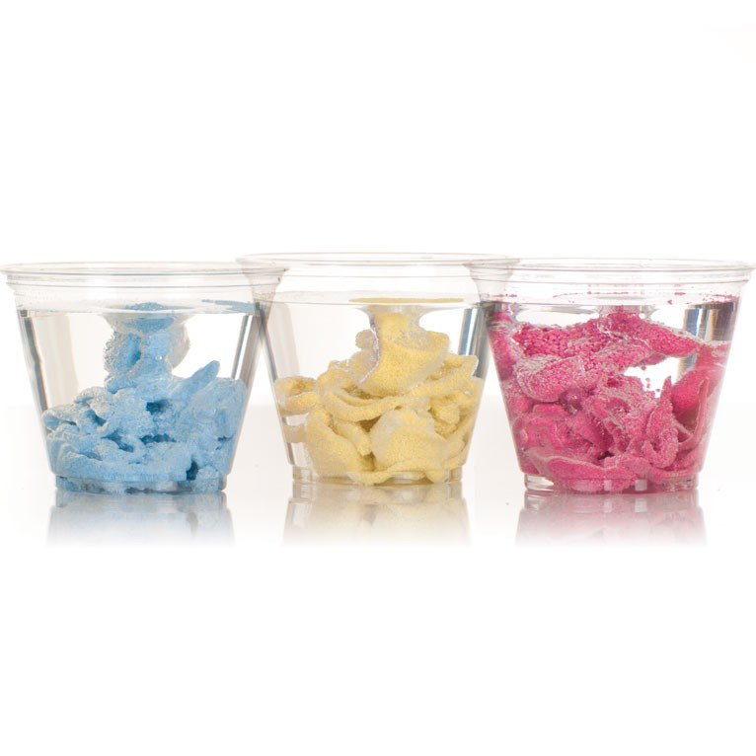
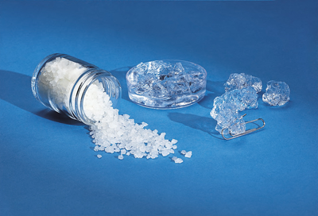
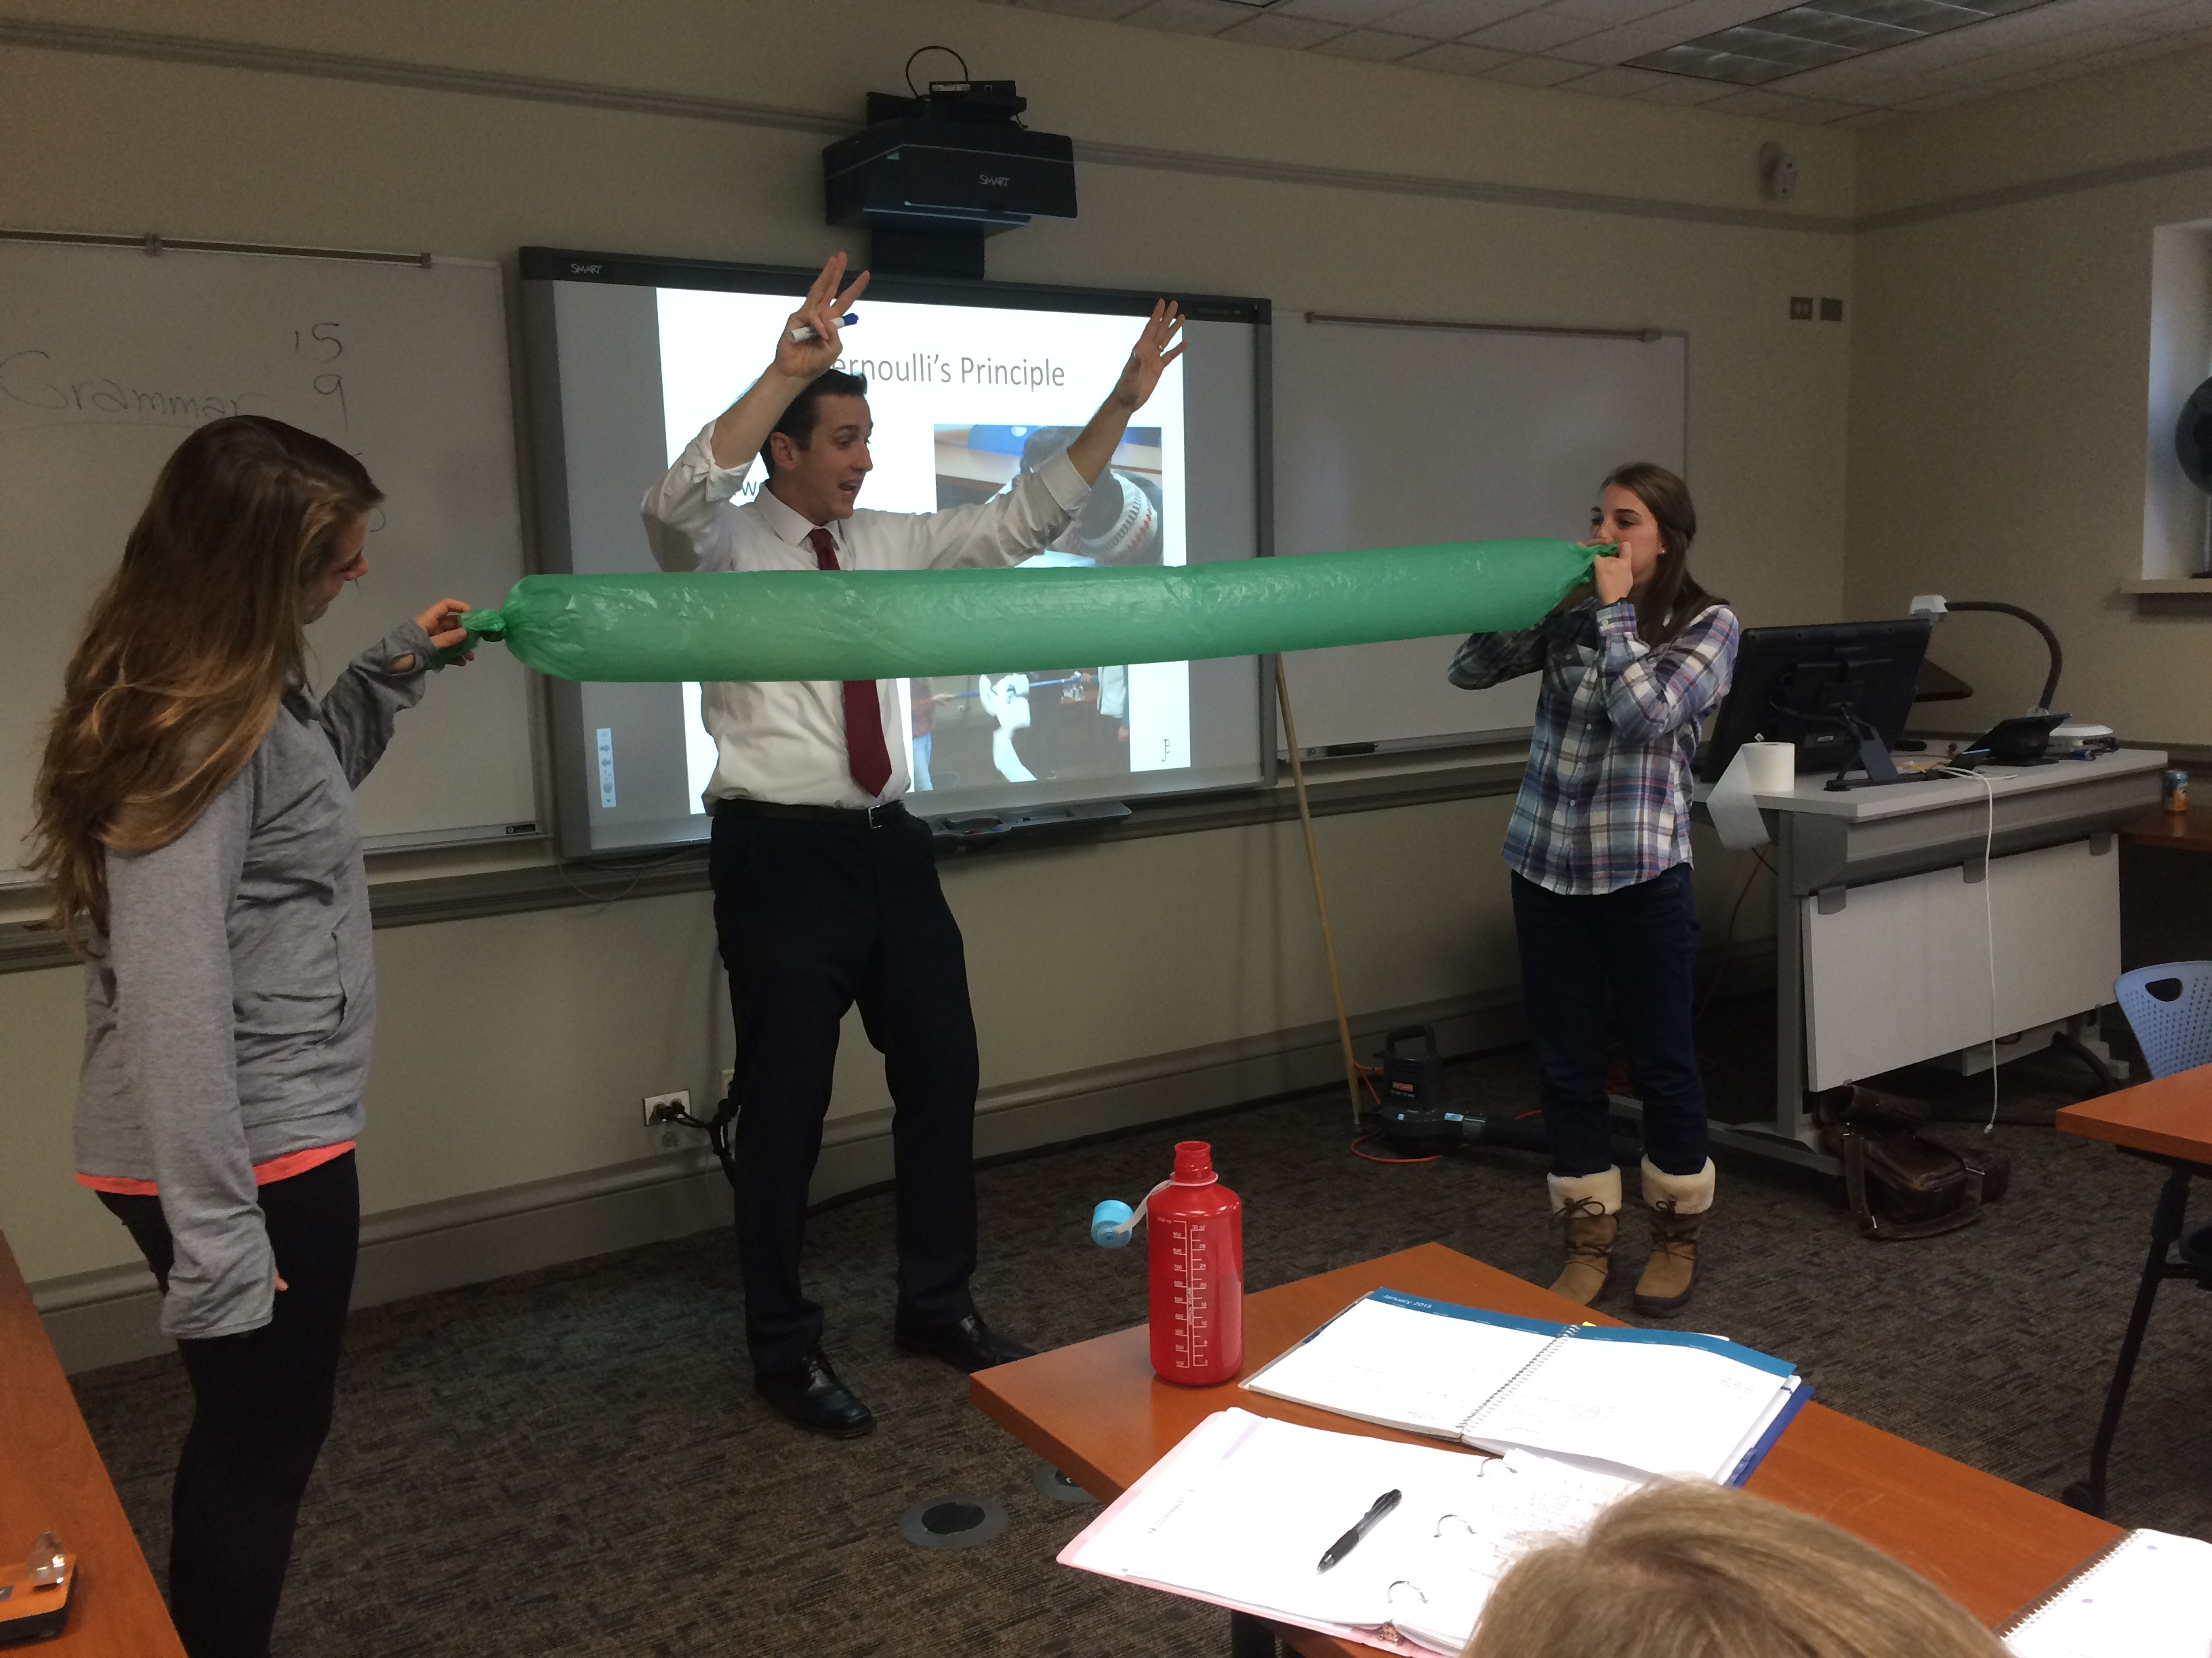




Slide 16
Questioning
Does metal sink or float?
What makes something sink or float?
Does it matter what the object is floating in?
What is density?
How can you decrease density if weight stays the same?
What is temperature?
How are density and temperature related?

Slide 17
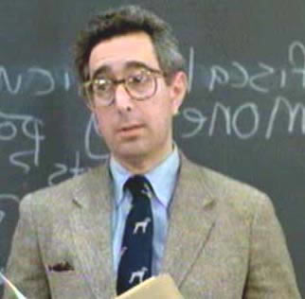
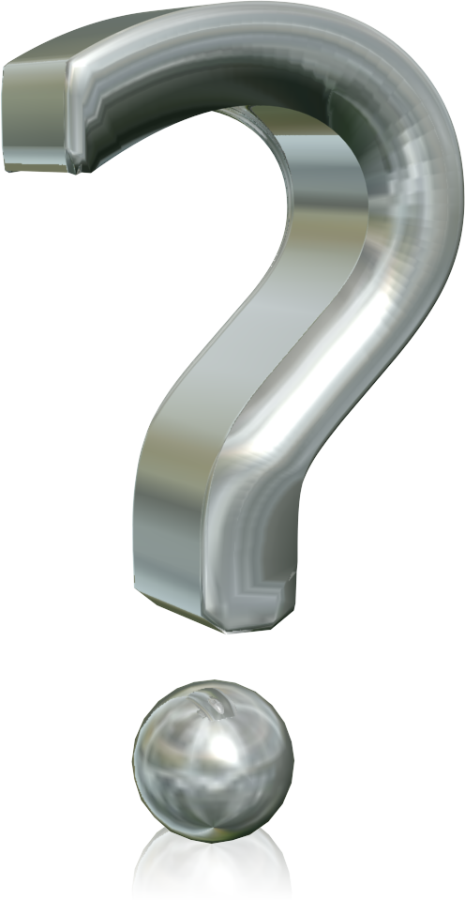
Questioning
Teachers ask between 30-120 questions per hour (Graesser & Person, 1994)
Teachers ask 93% of all questions (Graesser & Person, 1994)
70% of questions focus on knowledge and comprehension (Martin, Wood, & Stevens, 1988)
Higher-level questions with longer wait time increase achievement (Riley, 1986)
Higher achievers get more wait time and more opportunities to engage on higher order question (Krueger & Sutton 2001)
Notes:
11:35

Slide 18
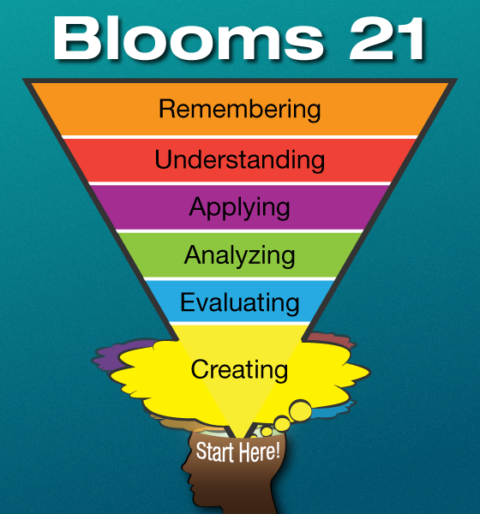
Ask Good Questions

Slide 19

Increasing wait time from 1 to 3 seconds
Student responses become 400-800% longer
The number of appropriate but unsolicited responses increases
Failure of students to respond decreases
Low achievers contribute up to 37% more
Speculative and predictive thinking can increase as much as 700%
Students respond and react more to each other (Rowe, 1970)

Slide 20
What is the difference between wait time 1 and wait time 2?

Slide 21
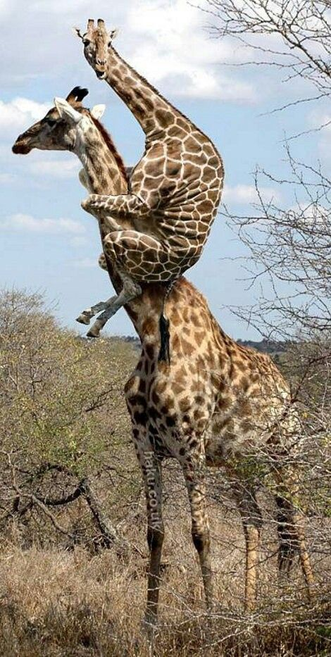
“If I have seen further than others, it is by standing on the shoulders of giants.”
- Sir Isaac Newton
Notes:
http://www.newyorker.com/magazine/2014/11/10/better-time

Slide 22

What will you do differently next week?
45 Minutes = ONE USEFUL IDEA

Slide 23


Resources
Jon.eckert@wheaton.edu
www.jonathanmeckert.com

